Slide 1

Design and Implementation of a Low-Cost STM32-Based Power Quality Analyzer with IoT-Enabled Web Dashboard
- Sponsored by AOT Solutions

Slide 2
Student Details:
Tanishq Swami (12311774)
Vedant Nandanwar (12311751)
Arush Wangikar (12311571)

Slide 3
introduction
Power quality refers to the characteristics of electrical power supply that enable equipment to function properly. Issues such as voltage sags, swells, harmonics, poor power factor, and frequency deviations are common in Indian electrical grids and can lead to equipment damage, energy wastage, and increased electricity costs.
Commercial power quality analyzers (Fluke 435-II, Hioki PQ3198) cost upwards of Rs.50,000, making them inaccessible for small-scale industries, workshops, and educational institutions.
This project proposes a low-cost, portable, IoT-enabled power quality monitoring system built around the STM32F411CEU6 microcontroller. It measures RMS voltage, current, power factor, real/apparent/reactive power, frequency, and Total Harmonic Distortion (THD) from a standard 230V AC mains supply in real-time.
Data is displayed on a local TFT screen and transmitted via WiFi to a web dashboard accessible from any phone or laptop, enabling remote monitoring and threshold-based alerts.

Slide 4
Literature Review
Sr. No. | Paper Title | Authors | Year | Key Findings | Limitations
1 | A Low-Cost Wireless Sensor System for Power Quality Management in Single-Phase Domestic Networks | Cristian A. Aldana B, Edison F. Montenegro A | 2023 | ESP32-based system using SCT013-030 current sensor for non-invasive monitoring. Measures power, power factor, THD, and energy consumption. Data published to Adafruit.io IoT cloud platform. High precision validated against network analyzer. | Uses only current sensor (no voltage measurement). Depends on cloud platform (Adafruit.io) for visualization. No local display for standalone operation. Single parameter focus (current-derived measurements only).
2 | Embedded System-Based Monitoring for Power Quality Analysis | Vedant Joshi | 2018 | ARM Cortex-M4 (STM32F407) based prototype. Uses CMSIS-DSP library for 256-point windowed FFT. Voltage sag/swell detection per IEEE 1159 guidelines. Measurement error within ±1.5%. Real-time UART alerts with <50ms latency. | No IoT/wireless connectivity for remote monitoring. Data logging limited to SPI flash memory. No web-based dashboard. Requires wired connection to PC for data visualization.
3 | An Embedded Application: Electric Power Quality Monitoring System | Dinesh G. Badshe, S. V. Pattalwar | 2012 | MSP430F148-based low-cost, low-power system. Monitors voltage, current, power, power factor, THD, and frequency. UART interface for communication with PC. Comprehensive coverage of PQ indices (SARFI, SATHD, etc.). | Uses older MSP430 platform with limited processing power. No wireless/IoT capability. Requires PC for display and analysis. No standalone portable operation.

Slide 5
Scope of project
Single-phase 230V AC mains power quality monitoring
Real-time measurement of voltage, current, power, power factor, frequency, and THD
FFT-based harmonic analysis up to the 10th harmonic
Local display on TFT screen with multiple pages (parameters, waveform, harmonic bar chart)
WiFi-based web dashboard for remote monitoring from any browser
Threshold-based alerting system (buzzer, LED, web alerts)
Battery-powered portable operation with galvanic isolation from mains
Data logging and CSV export via web dashboard

Slide 6
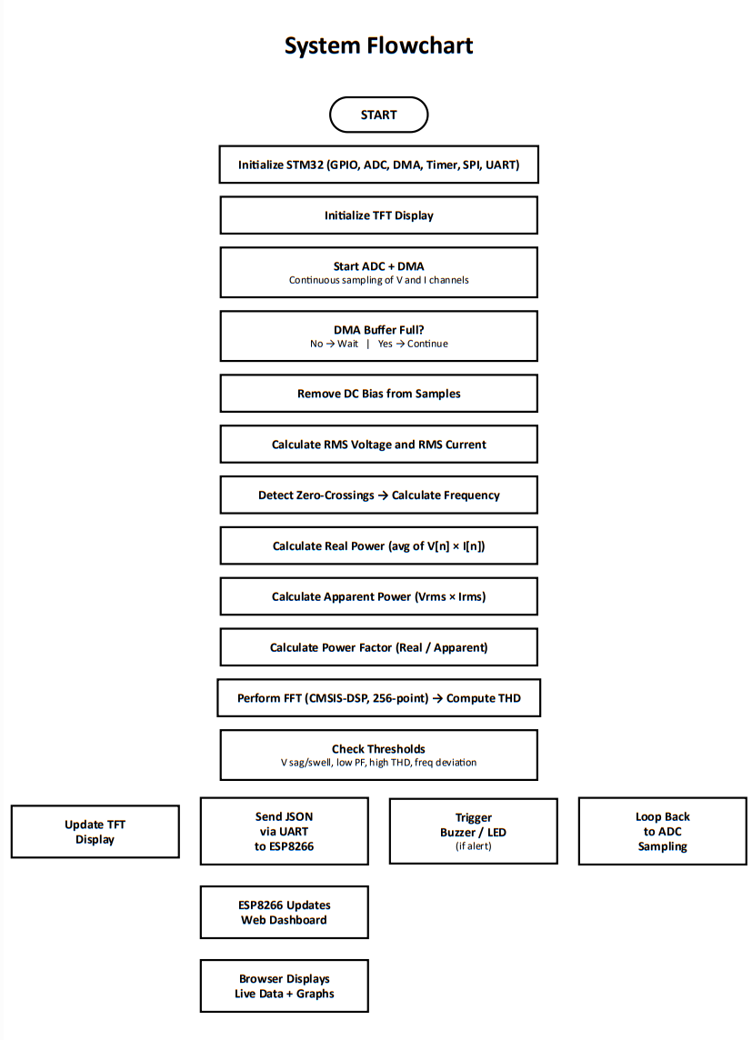

Slide 7
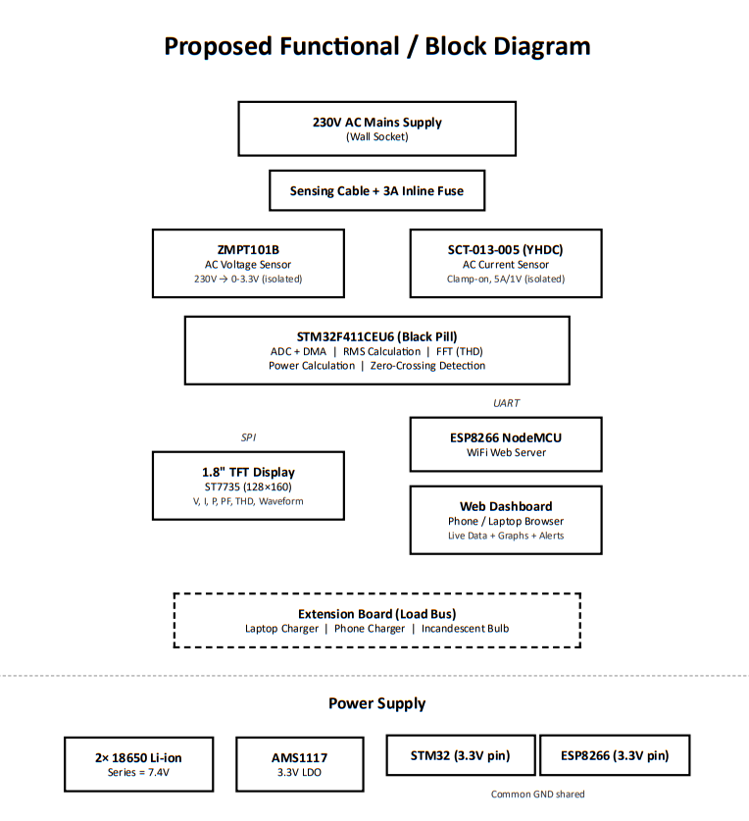

Slide 8
Hardware components to be used
Sr No. | Component | Qty | Purpose
1 | STM32F411CEU6 (Black Pill) | 1 | Main microcontroller
2 | ESP8266 NodeMCU v3 | 1 | WiFi module + web dashboard
3 | ZMPT101B voltage sensor | 1 | AC voltage sensing
4 | SCT-013-005 (YHDC) current sensor | 1 | AC current sensing (clamp-on)
5 | 1.8" TFT Display (ST7735) | 1 | Local display
6 | ST-Link V2 programmer | 1 | Flashing STM32 firmware
7 | 18650 Li-ion batteries (3.7V) | 2 | Power source (7.4V series)
8 | 18650 battery holder (2-slot) | 1 | Battery mounting
9 | AMS1117 3.3V regulator | 1 | Voltage regulation for STM32
10 | Extension cord + Extension board | 1+1 | Sensing cable + load bus
11 | 3A inline fuse + holder | 1 | Safety protection
12 | Active buzzer + LEDs | 1+2 | Alert indicators
13 | Breadboard + jumper wires | 1+2 packs | Prototyping
14 | Incandescent bulb + holder | 1 | Test load for demo
15 | Electrical tape + misc | 1 | Insulation and connections

Slide 9
Software required
# | Software / Library | Purpose
1 | STM32CubeIDE | STM32 firmware development (C language)
2 | STM32 HAL Drivers | Hardware abstraction layer for ADC, DMA, Timer, SPI, UART, GPIO
3 | CMSIS-DSP Library | Optimized FFT computation on ARM Cortex-M3
4 | Arduino IDE | ESP8266 firmware development (C/C++)
5 | ESP8266 Arduino Core | WiFi, web server, and SPIFFS libraries
6 | HTML + CSS + JavaScript | Web dashboard (served from ESP8266)
7 | Chart.js | Browser-based charting library for live graphs on dashboard

Slide 10
Expected output
1. Real-Time Measurements on TFT Display:
RMS Voltage (~230V), RMS Current, Frequency (~50Hz)
Real Power (W), Apparent Power (VA), Reactive Power (VAR)
Power Factor (0 to 1.0)
THD percentage with harmonic bar chart
Live voltage waveform (oscilloscope-style view)
2. Web Dashboard (accessible from any browser on same WiFi):
Live updating numerical values of all parameters
Historical trend graphs (voltage and current over time)
Threshold alerts highlighted in red
CSV data export for offline analysis
3. Alert System:
Buzzer sounds on threshold breach
Red LED turns on for visual alert
Web dashboard highlights parameter in red
4. Expected Accuracy:
Voltage measurement: ±2% of multimeter reading
Current measurement: ±3% of multimeter reading
Frequency detection: ±0.1 Hz
THD computation: ±2% compared to reference analyzer

